Slide 1
JENKINS MASTER SLAVE CONFIGURATION BY SANGITA PAUL

Slide 2
INTRODUCTION
JENKINS:
Jenkins is a tool that is used for automation, and it is an open-source server that allows all the developers to build, test and deploy software. It works or runs on java as it is written in java. By using Jenkins we can make a continuous integration of projects(jobs) or end-to-endpoint automation.

Slide 3
Jenkins Master-Slave Configuration
Jenkins uses a Master-Slave architecture to manage distributed builds. In this architecture, Master and Slave communicate through TCP/IP protocol.

Slide 4
JENKINS MASTER
The main Jenkins server is the master .The master’s job is to handle :-
Scheduling build jobs
Dispatching builds to the slaves for actual execution.
Monitor the slaves(possibly taking them online or offline as required.
Recording and presenting the build results.
A master instance of Jenkins can also execute build jobs directly.

Slide 5
JENKINS SLAVE
A slave is a Java executable that runs on remote machine .Below are the characteristics of the Jenkins Slave :-
It hears the requests from the Jenkins Master instance
Slaves can run on variety of operating systems.
The job of a Slave is to do as they are told to, which involves executing build jobs dispatched by the Master.
We can configure a project to always run on a particular Slave machine or a particular type of Slave machine, or simply let Jenkins pick the next available Slave.

Slide 6
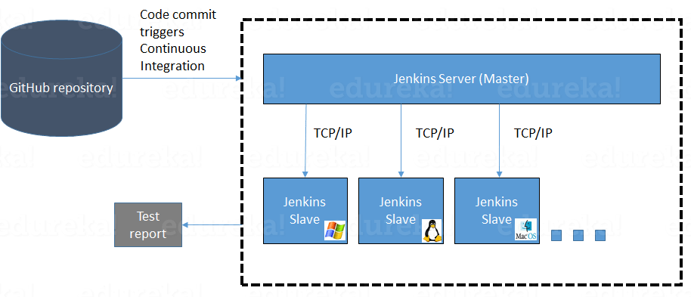
Flow diagram

Slide 7
STEPS to BE followed
Create two EC2 instances one for master and other one is for slave.
Install Jenkins software in Master instance and open Jenkins in browser by copying the IP address of the instance.
Install java in slave instance and create a slave in the instance and generate a SSH key and copy it to authorised keys and assign required permissions.
Copy the slave nodes IP address to the master instance known host file.
Assign the required permissions to known host file.
Click on “Manage Jenkins”→ ”Nodes and clouds” in Jenkins (Browser)
Create a node and g ive the details of the slave and save it.
Click on “Log”, now your slave is online and deploy job in that slave
We can check deployed project in slave instance i.e., in workspace

Slide 8
COMMANDs for Jenkins MASTER INSTALLATION
sudo wget -O /etc/yum.repos.d/jenkins.repo \https://pkg.jenkins.io/redhat-stable/jenkins.repo
sudo rpm --import https://pkg.jenkins.io/redhat-stable/jenkins.io-2023.key
sudo yum upgrade
sudo dnf install java-11-amazon-corretto -y
sudo yum install jenkins -y
sudo systemctl enable jenkins
sudo systemctl start jenkins

Slide 9
COMMANDs for Jenkins INSTALLATION
Creating directory, file and pasting the IP address of slave in a file and assigning permissions to it:
sudo mkdir -p /var/lib/jenkins/.ssh
cd /var/lib/jenkins/.ssh
cd ..
sudo chmod 777 .ssh
cd .ssh
sudo ssh-keyscan -H SLAVE_NODE_PRIVATE_IP >>/var/lib/jenkins/.ssh/known_hosts
sudo chown jenkins:jenkins known_hosts
sudo chmod 700 known_hosts

Slide 10
COMMANDs for Jenkins SLAVE INSTALLATION
Create user, ssh keys and copy it to authorized_keys and assign required permissions:
sudo useradd jenkins-slave1
sudo passed Jenkins-slave1
sudo su - jenkins-slave1
ssh-keygen -t rsa -N "" -f /home/jenkins-slave1/.ssh/id_rsa
cd .ssh
cat id_rsa.pub > authorized_keys
chmod 700 authorized_keys

Slide 11
THANK YOU BY SANGITA PAUL

